Slide 1
Store Sales - Time Series Forecasting
PRESENTED BY :
Vamshidhar reddy gurrapagari-vgurappa@kent.edu
Sai shresta Bireddy - sbireddy@kent.edu
Suma chakravarthy balla- sballa2@kent.edu
Bharat simha reddy pasam – bpasam@kent.edu

Slide 2
statement of the project objectives
In this project we are going to forecast the store sales from corporacion Favorita which is located in Ecuador which is a big grocery retailer. The data includes the store information as well as product information and the particular item is promoted or not and how many number of sales generated in a day as well as weekly and monthly. based on that the time series forecasting will predict the future values.
The purpose of this study it generally gives some basic idea for business peoples. so that they will get some inputs . Based on these inputs they typically understand the procedure of supply chain as well as increasing or decreasing Profits.

Slide 3
identify the customer
In the project we identified the customers are the owners of the store corporacion Favorita who approached us about the application with their requirements.

Slide 4
identify the end-users
In the project we identified the end users to be the management staff of the store who needs to know the unit sales of each product.

Slide 5
constraints imposed by the customer
The main constraints imposed are
The time period of products sold
Selling rate of the product
Different categories of people buying different products
Accuracy of model

Slide 6
tools you are expecting to utilize in your project.
Language- Python
To test and train the data- scikit
Visual studio code
Machine learning algorithms

Slide 7
Why is important to solve this problem?
In grocery business, the proposed model can fetch more exact forecasting that can reduced food waste from out-stocking and improve customer satisfaction. The result of this project may eventually ensure your local store has exactly what you need at the next time you shop.

Slide 8
Literature Review

Slide 9
PAPER-1 - Predictive Analysis for Big Mart Sales Using Machine Learning Algorithms R. P and S. M, "Predictive Analysis for Big Mart Sales Using Machine Learning Algorithms," 2021 5th International Conference on Intelligent Computing and Control Systems (ICICCS), 2021, pp. 1416-1421, doi: 10.1109/ICICCS51141.2021.9432109.
This paper focused on Big mart sales, here this paper concentrates more on how different types of machine learning models yield results on a single dataset.
The machine learning models used are Linear Regression Classifier, Polynomial Regression Classifier, Ridge Classifier, XgBoost Classifier
These are compared to the result which includes Accuracy, RMSE, MAE, MSE parameters.
After going through the results, Ridge and Xgboost regression gives the better prediction with respect to Accuracy, MAE and RMSE than the Linear and polynomial regression approaches.

Slide 10
PAPER-2 Retail Demand Forecasting: a Comparison between Deep Neural Network and Gradient Boosting for Univariate Time Series K. Wanchoo, "Retail Demand Forecasting: a Comparison between Deep Neural Network and Gradient Boosting Method for Univariate Time Series," 2019 IEEE 5th International Conference for Convergence in Technology (I2CT), 2019, pp. 1-5, doi: 10.1109/I2CT45611.2019.9033651.
This paper compares the performance of Deep Neural Network and Gradient Boosting. In this paper, the data set considered was of German drug store, Rossman stores which were available on Kaggle.
After compilation of both algorithms they were compared with respect to parameters RMSE(RMSE is the Root of the Mean of the Square of Errors) and MAE (Mean of Absolute value of Errors).
After comparison Gradient boosting performed well than the deep neural network.

Slide 11
Parameters choosing in Deep Neural Network
Number of hidden layers
Activation functions to be used in each layer
Weight initialization method
Optimizer function and learning rate
Number of epochs
Batch size for each iteration

Slide 12
Parameters choosing in Gradient Boosting
Maximum depth of a tree
Subsample: Fraction of observations to be selected for each tree
Number of sequential trees to be modeled
Learning rate
Random number seed
Loss function to be minimized in each split

Slide 13
PAPER-3- Ensemble Approach for Time Series Analysis in Demand Forecasting A. O. Akyuz, M. Uysal, B. A. Bulbul and M. O. Uysal, "Ensemble approach for time series analysis in demand forecasting: Ensemble learning," 2017 IEEE International Conference on INnovations in Intelligent SysTems and Applications (INISTA), 2017, pp. 7-12, doi: 10.1109/INISTA.2017.8001123.
This Paper mainly focuses on Demand forecasting it is the period of forecasting future customer requirements with some degree of sensitivity using statistical techniques, considering past historical demand data and other variables.
. This study showed a new heuristic approach to ensemble methodology.
The results of this approach and procedure showed the advantages of strong prediction over time-series predictive analysis
METHODS USED IN PAPER :
statistical forecasting context with Time Series algorithms
ensemble approach for prediction algorithms

Slide 14
OUTPUT of literature review
After going through all those papers, we decided to use XGboost for our project by comparing with various Algorithms like linear regression, Ridge regression XGboost yield better result with respect to Accuracy, MAE and RMSE. So, we choose XGboost.

Slide 15
Data Exploration
We are using 7 different files in the dataset. They are:
1. Holidays_events: Holidays and Events, with metadata.
2. Train: The training data, comprising time series of features store_nbr, family, and onpromotion as well as the target sales.
3. Test: The test data, having the same features as the training data. You will predict the target sales for the dates in this file.
4. Sample_submission: A sample submission file in the correct format.
5. Stores: Stores metadata, including city, state, type, and cluster.
6. Oil: Daily oil price. Includes values during both the train and test data timeframes.
7. Transaction: Dates of transactions

Slide 16
Data Exploration
After going through dataset, we found that no data is missing. Incase if we find any missing data we will replace it with mean value or we could omit them.
we going to use jupyter notebook to run the code.

Slide 17
What is xgboost?
XGBoost (eXtreme Gradient Boosting) is a popular supervised-learning algorithm used for regression and classification on large datasets.
It uses sequentially-built decision trees to provide accurate results and a highly-scalable training method that avoids overfitting.

Slide 18
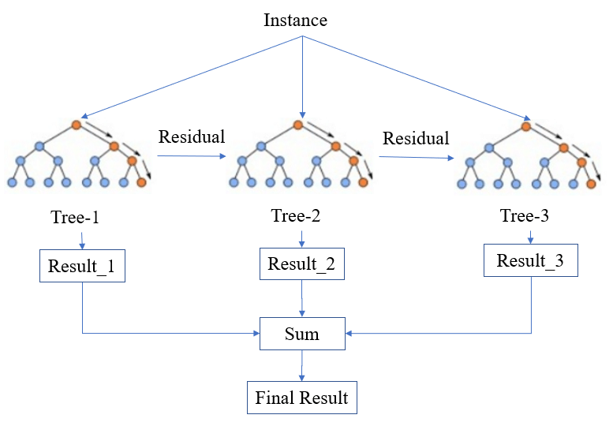

Slide 19
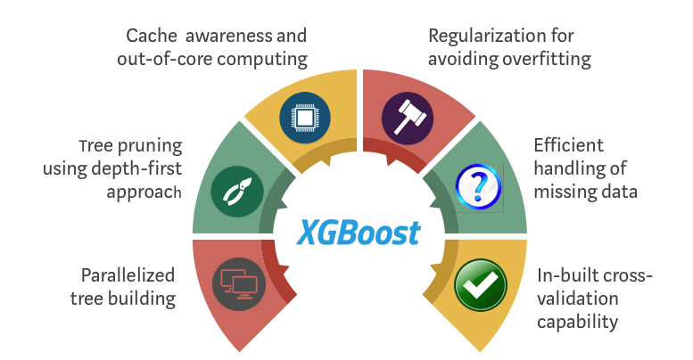
why xgboost?
After comparing with various Algorithms like linear regression, Ridge regression Xgboost yeild better result with respect to Accuracy, MAE and RMSE. So, we choose xgboost.
It is fast and easy to use
Can handle missing values automatically

Slide 20
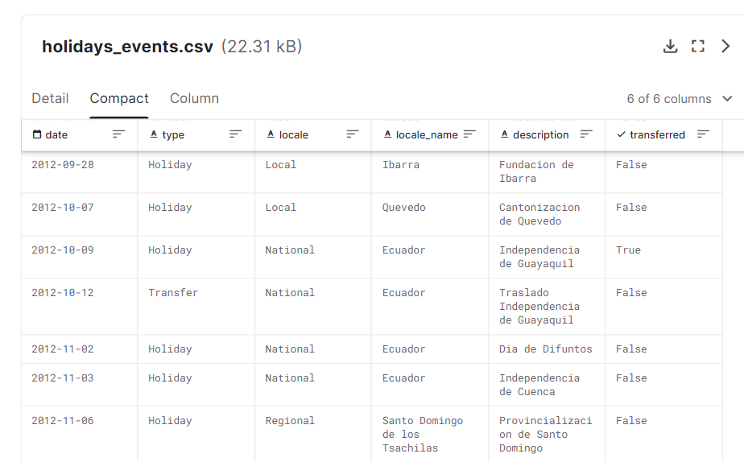
holidays_events.csv

Slide 21
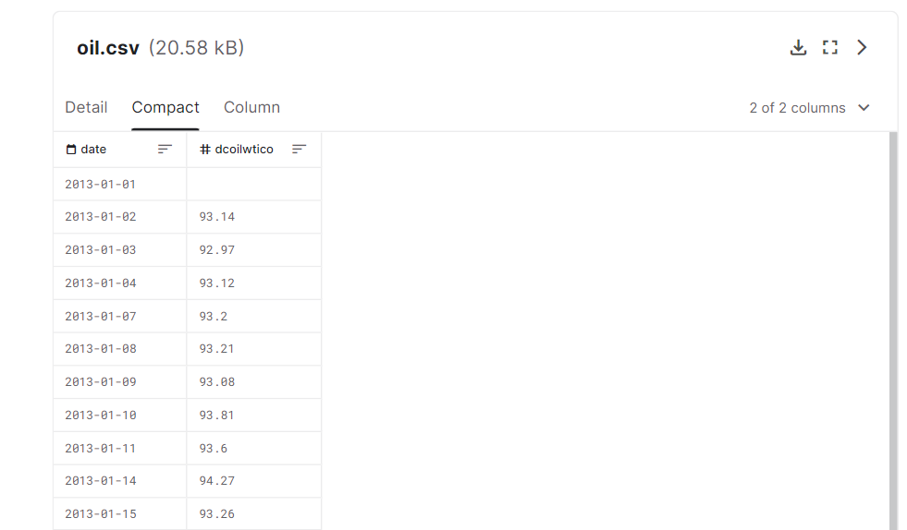
Oil.csv

Slide 22
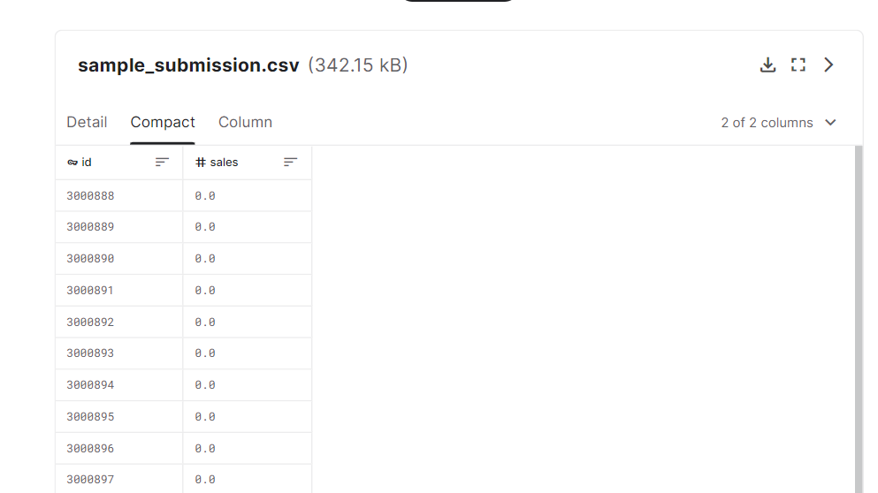
sample_submission.csv

Slide 23
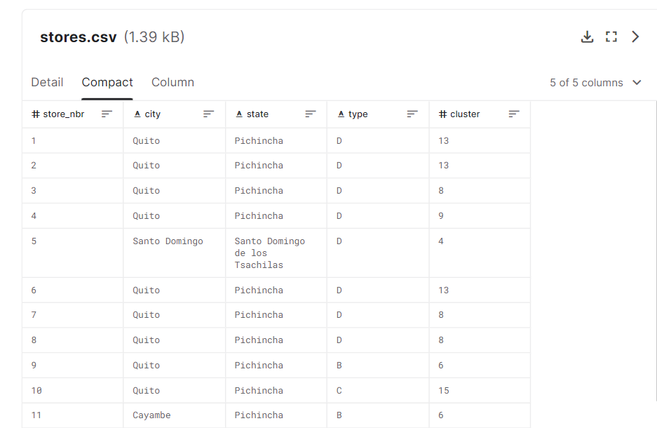
Stores.csv

Slide 24
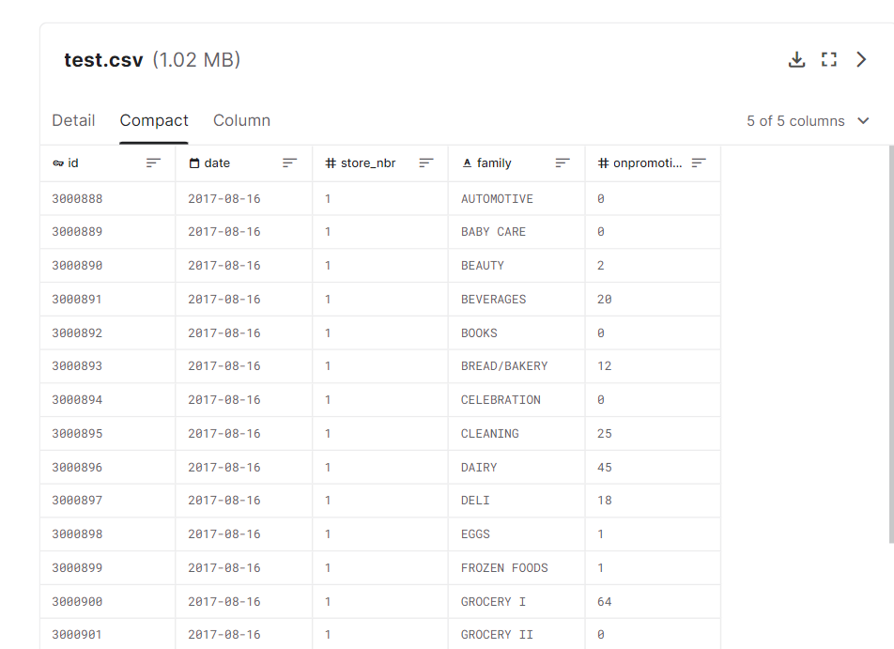
Test.csv

Slide 25
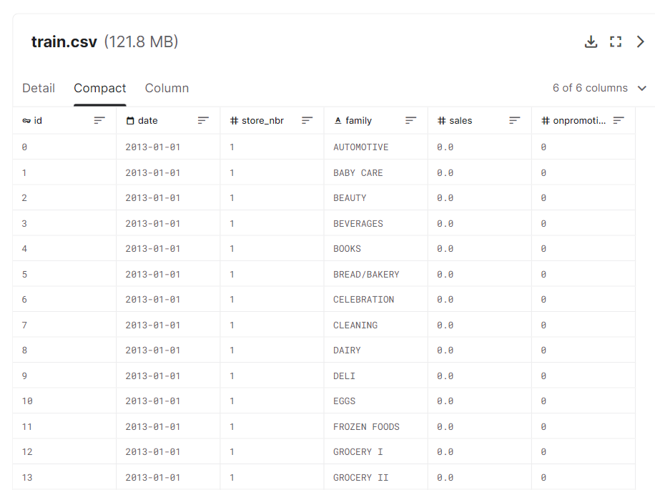
Train.csv

Slide 26
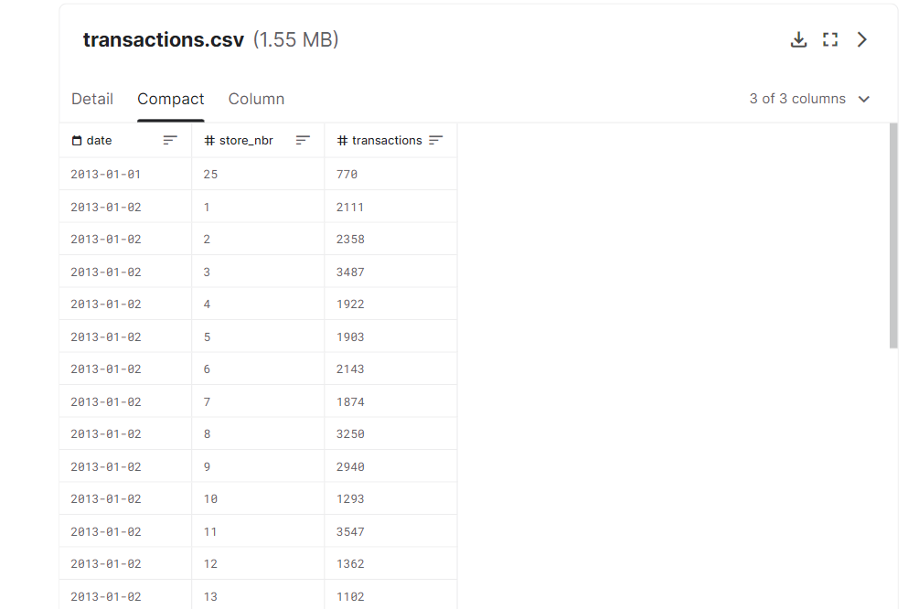
Transactions.csv

Slide 27
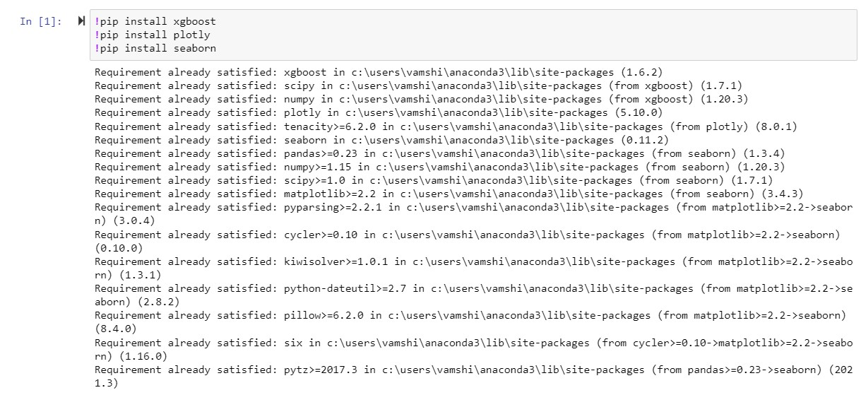
EXECUTION OF PROJECT

Slide 28
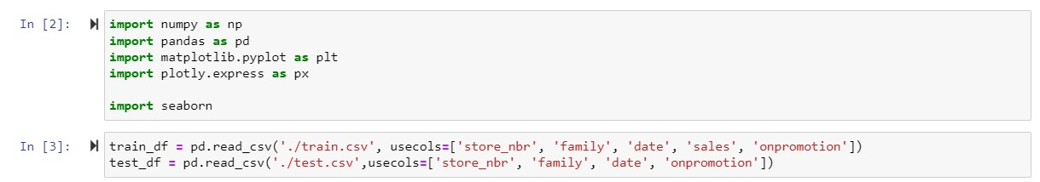
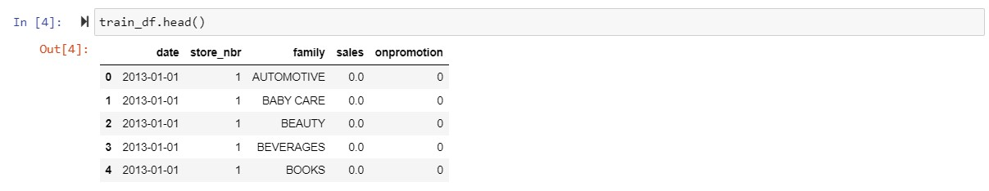

Slide 29
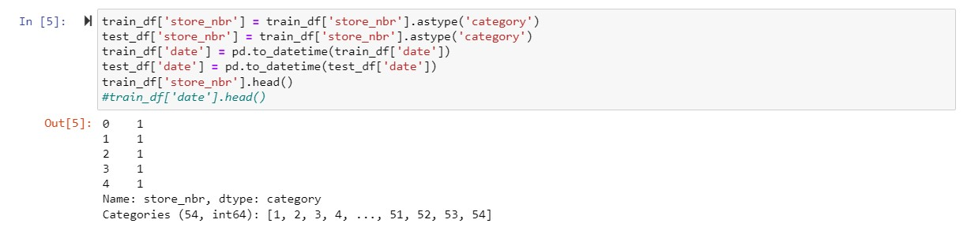
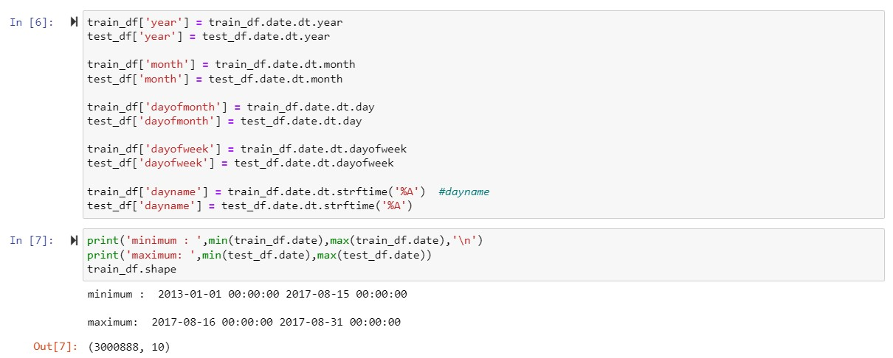

Slide 30
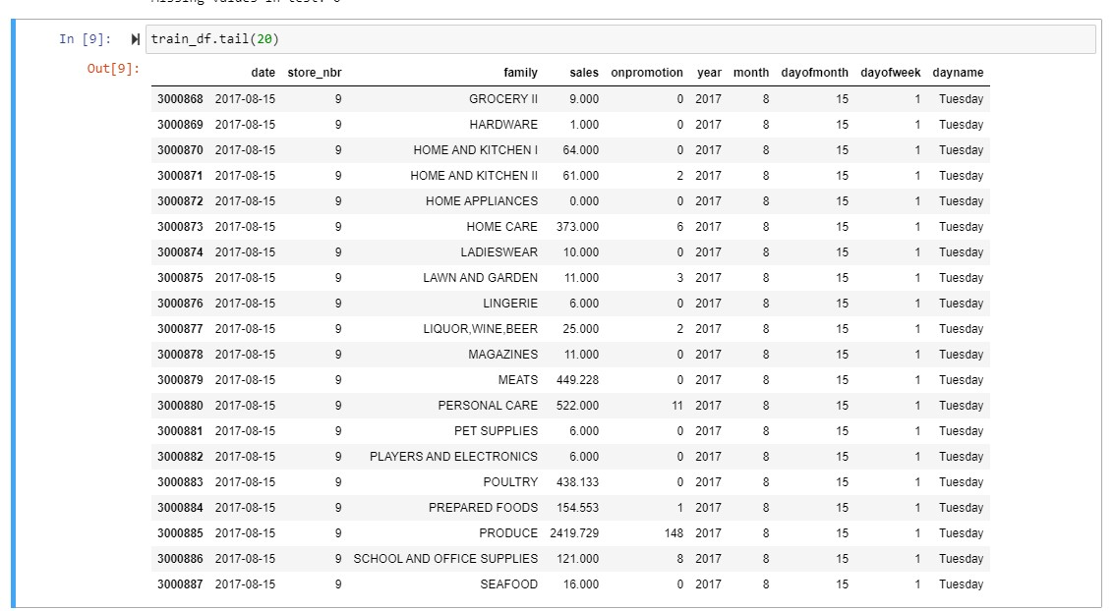

Slide 31
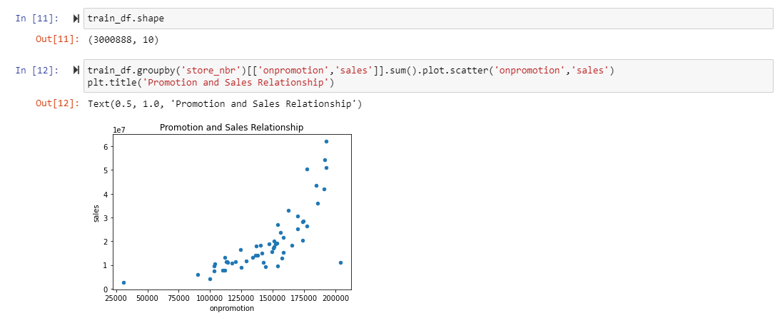

Slide 32
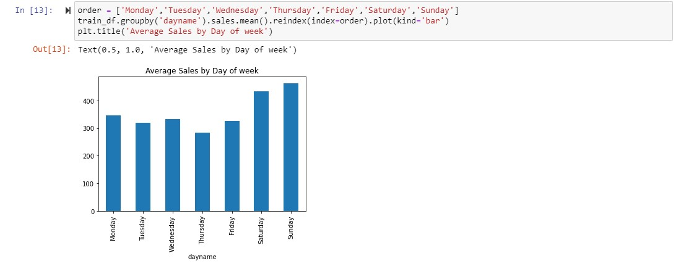

Slide 33
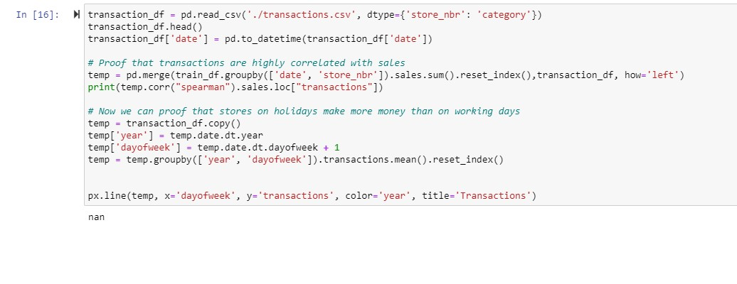
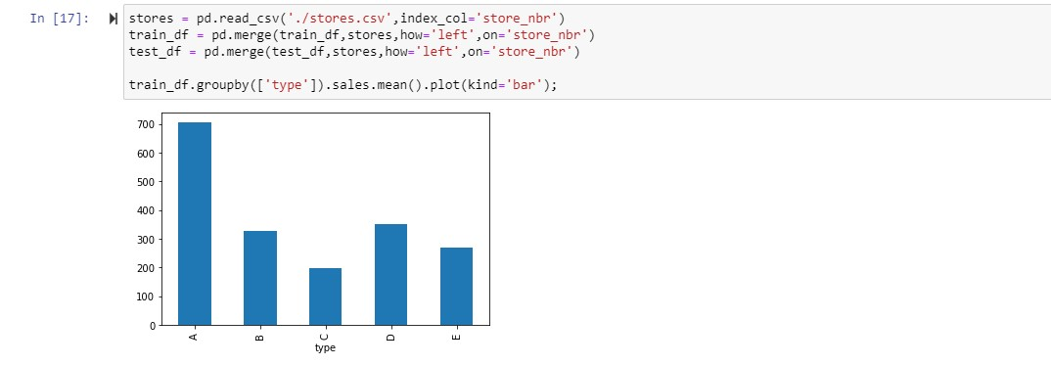

Slide 34
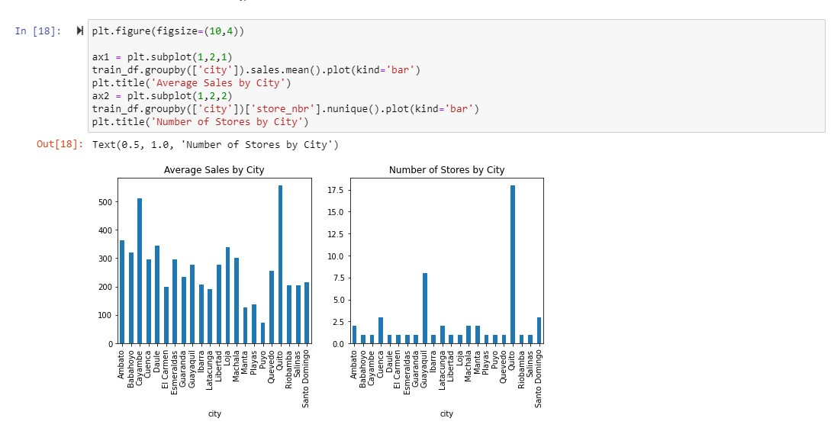

Slide 35
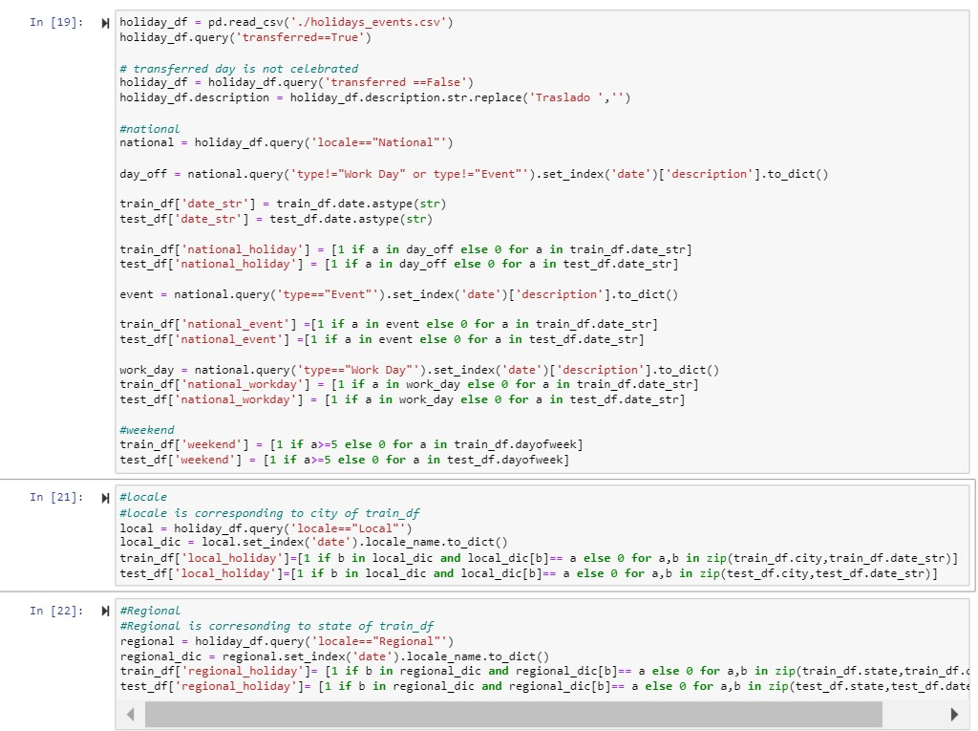

Slide 36
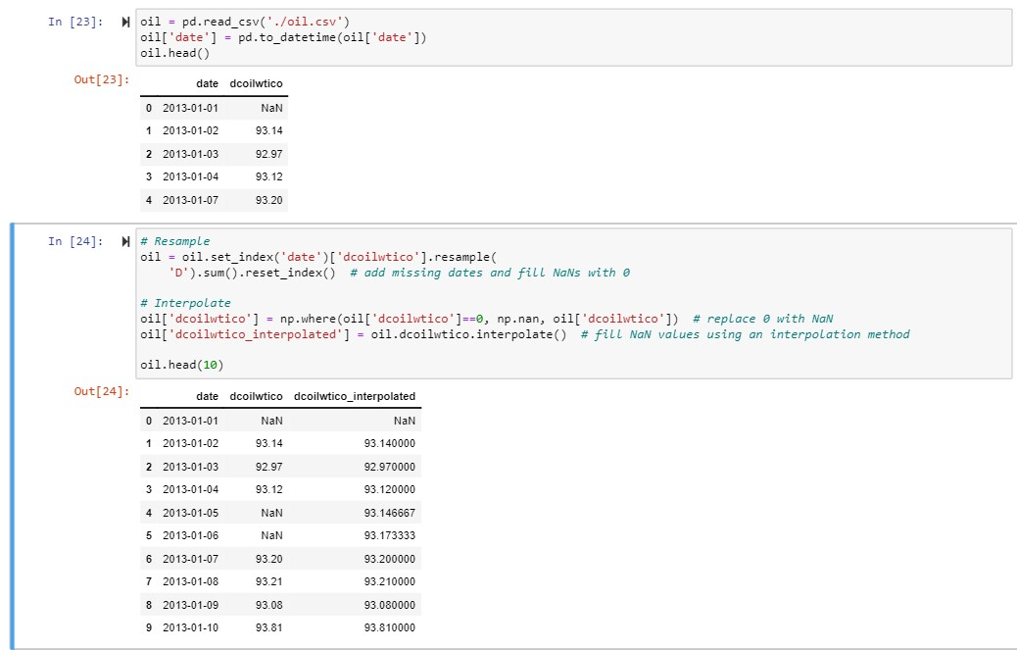
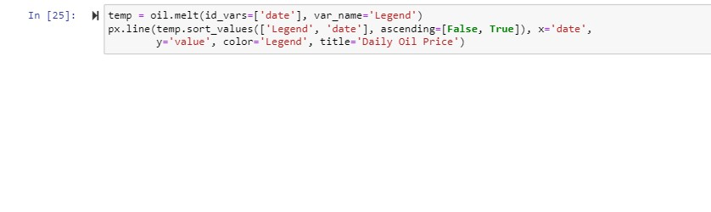

Slide 37
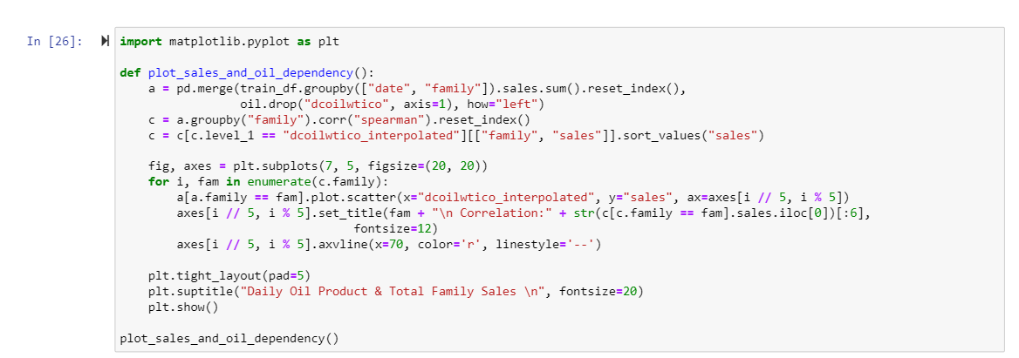
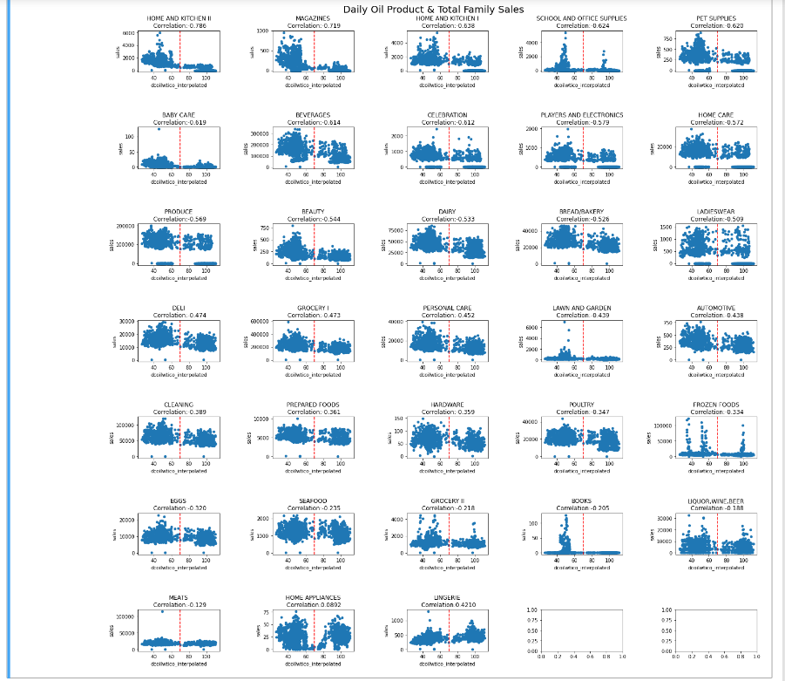

Slide 38
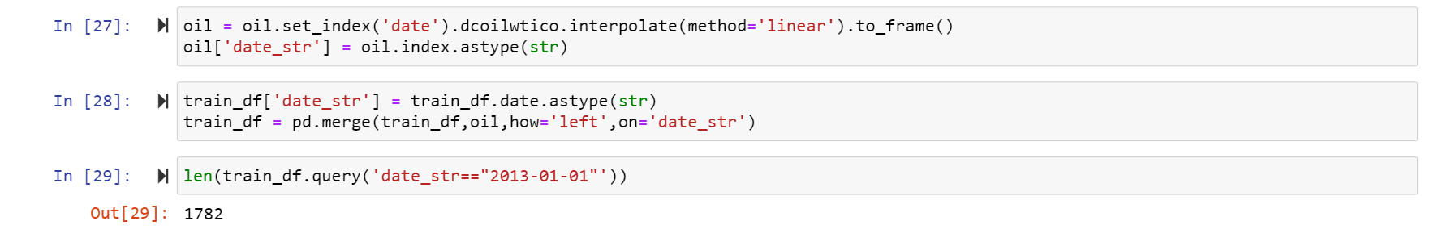

Slide 39
Thankyou!

